Slide 1
TOPIC 2: MARKETING MANAGEMENT PHILOSOPHIES

Slide 2
Marketing Management Philosophies
Customer-Driven
Societal Marketing Concept
Marketing Concept
Selling Concept
Product Concept
Production Concept

Slide 3
THE PRODUCTION CONCEPT
Holds that consumers favor products that are available and affordable. Management emphasizes production and distribution efficiency.

Slide 4
Situations for production concept
When the demand of the product exceeds supply, management should look for ways to increase production.
When the products cost is too high improved productivity is needed to bring it down.

Slide 5
Product concept
It implies a good product will sell itself, or "we don't need a sales department because we can sell everything we can produce
Consumers favor products that offer the most quality, performance, and innovative features, and that the organization should devote its energy to making continuous product improvements.

Slide 6
Selling concept
Products, even good ones, don't necessarily sell themselves.
Customers must be convinced to buy products.
Consumers will buy products only if the company aggressively promotes/sells these products.
Most firms practice selling concept when they have overcapacity.
Their aim is to sell what they make rather than make what the market wants.

Slide 7
The marketing concept
Focuses on needs and wants of target markets and delivering value better than competitors.

Slide 8
Stages in the marketing concept (the 4 main pillars)
1. Target market
  no company can operate in every market satisfying every need. Companies do best when they define their target markets and prepare targeted marketing programs.
2. Customer needs;
  information systems are established that enable management to discover customer needs of these target groups.
3. Coordinated marketing;
  the organization is restructured to coordinate all activities toward satisfying the customer profitably.
4. Profitability;
  the company needs to satisfy the need better than the competition & therefore should aim to make money through satisfying the customer needs.

Slide 9
Criticism of marketing concept
Limited resources;
    it is not possible in the long run to satisfy everyone’s needs worldwide.
The role of “anticipation of needs”
    may indirectly lead to the charge that marketing creates needs and in the process causes customer to buy things they could be happy without.

Slide 10
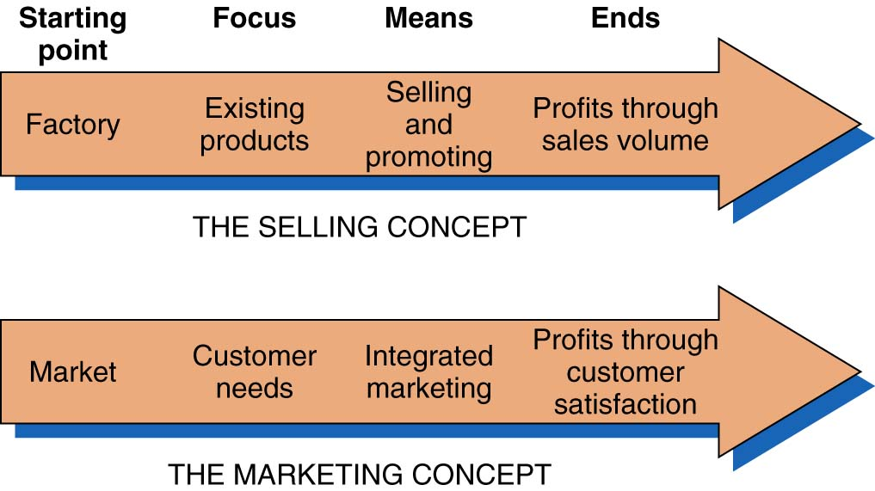
Marketing and Selling Concepts Contrasted

Slide 11
Societal marketing concept
Adds to the marketing concept the idea that the company should contribute to the betterment of society as a whole.
The idea that the organization should determine needs, wants, and interests of target market and deliver the desired satisfactions more effectively and efficiently than the competitors in a way that maintains or improves the consumers and society’s wellbeing.

Slide 12
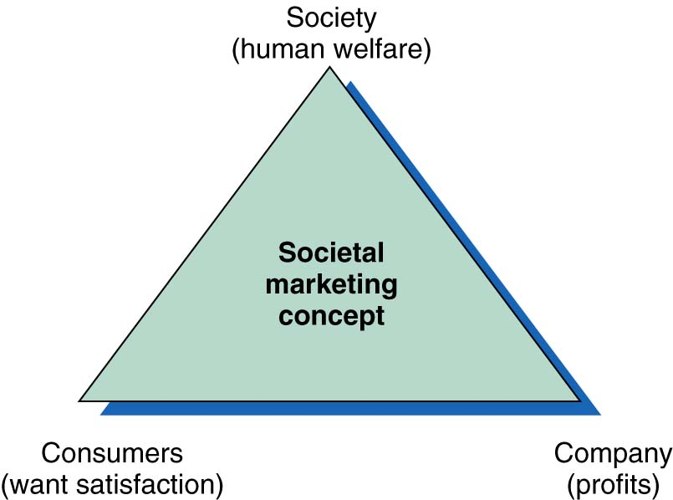
Societal Marketing Concept

Slide 13
Current marketing challenges
Rapid and increased Changing in customer values and orientations.
Economic stagnation.
Environmental decline.
Increased global competition
  However these problems also provide marketing opportunities

Slide 14
Course work one hand in next week.
Define what marketing is and discuss its core concepts.
Examine how marketers manage demand and build profitable customer relationships using information technology.
Companies must use technologies to let them connect more directly with their customers. Discuss.
Do it in groups of 3.

Slide 15
TOPIC 3: THE MARKETING ENVIRONMENT

Slide 16
LEARNING OBJECTIVES
At the end of this lecture students will be able to;
List the elements of the marketing mix
list the elements of external environment
Define controllable and uncontrollable factors
explain each type of the internal environment
Give a list of examples as found in the industry.

Slide 17
The marketing environment
“It is useless to tell a river to stop running; the best thing is to learn how to swim in the direction it is flowing.” (Anonymous)
Focus is on marketing implications of the environment

Slide 18
What is marketing environment?
This comprises of all those individuals, organizations and other environmental forces that affect marketing operations.
A company’s marketing environment consists of the outside actors and forces that affect the company’s ability to develop and maintain successful transactions with its target customers.

Slide 19
DEFINING THE MARKETING ENVIRONMENT
There are two major types;
  Internal marketing environment
  External marketing environment

Slide 20
External environment (largely uncontrollable)
May be divided in two groups;
  The micro and macro environments which are further divided;

Slide 21
The external environment
Macro environment | Micro environment
1. Demography 2. Economic conditions 3. Competition 4. Social and cultural factors 5. Political and legal forces 6. Technology 7. National environmental forces | The market ( customers) Suppliers Marketing intermediaries

Slide 22
Macro environment
1. Demography; is the study of human populations in terms of size, density, location, age, sex, race, occupation, and other statistics.
Is the human population and its distribution.
Changes in demography greatly affects the marketing systems.
An increase in population may mean an increase in potential customers and vicevasa.
Demography is of great interest to marketers because it involves people and people make up the market.

Slide 23
Macro environment…
2. Economic conditions;
Consist of factors that affect consumers purchasing power and spending patterns.
There cannot be a sufficient market unless the people have the purchasing power (money) and they are willing to buy (spend the money).

Slide 24
Macro environment…
Economic forces that influence the marketing activities;
peoples incomes and their willingness to buy.
Interest rates
Inflation; a general persistent rise in the price levels in the economy.

Slide 25
Macro environment…
3. competition;
A wise firm needs to monitor the competitors marketing activities such as their products, pricing, promotion programs and distribution.
A firm that does not cope with competition will be pushed out of market and out of business.

Slide 26
Macro environment…
4. social and cultural forces;
This is made up of institutions and other forces that affect societies basic values, perceptions preferences, and behavior.
Such cultural values or patterns affect marketing decisions, they include; life styles, social values, beliefs, which are changing so fast.
Marketers should take cultural values into account when planning to implement their marketing programmes.

Slide 27
Macro environment…
5. Political /legal forces;
  These consist of laws, policies, legislation, government agencies and pressure groups that influence and limit organizations and individuals in a society.

Slide 28
Macro environment…
Some of the legislation and policies include;
Legislations regulating business or specification related to marketing.
General monetary and fiscal policies.
Governmental relationship with individual industries.
etc

Slide 29
Macro environment…
6. Technology
Technology has a tremendous impact on our lifestyles, consumption patterns, and economic wellbeing.
It affects the way things are done in marketing or in business.
New technologies create new markets and opportunities

Slide 30
Macro environment…
Major technological changes may also have the following impact;
Start entirely new industries
Radically alter or virtually destroy existing industries.
Stimulate other markets and industries not related to the new technology.

Slide 31
Macro environment…
Technology contd;
When marketers fight or ignore new technologies, their business declines.
Marketers need to understand the changing technological environment and the ways that new technologies can serve human beings.

Slide 32
Micro Environment
The micro environment consists of factors and forces close to the company that can affect its ability to serve its customers.
1. The market;
The market is the focal point of all marketing decisions in a firm .
A firm needs to have a fair grasp of its market.
Customers in the micro environment include;
    past customers, current customers, and potential customers.

Slide 33
Micro Environment…
2. suppliers
these are firms that provide the resources for producing goods and services.
The marketer must carefully watch supply, availability of these resources.
He needs to avoid delays, shortages, and monitor price trends of suppliers.

Slide 34
Micro Environment…
3. market intermediaries;
These are firms that promote, sell and distribute the company’s goods to the final buyer.
They include middlemen, (retailers, wholesalers), physical distribution firms, marketing service agencies, and financial intermediaries

Slide 35
Internal environment (controllable)
Includes; the company’ other departments and the marketing mix.

Slide 36
Internal environment (controllable)
Departments;
In designing marketing plans marketing management should take into account other departments such as;
Financial dept and financial capabilities
Production/ manufacturing and facilities
Human resource dept.
Research and development (R&D) dept capabilities.
Purchasing dept.
Accounting dept.
Top management

Slide 37
Internal environment (controllable)
Top management sets the company’s mission, objectives, broad strategies and policies.
Marketing management must make decisions within the plans made by top management.
Marketing manangement must also work closely with other depts which must find funds, desgn attractive products, procure supplies and materials and measure revenues and costs.
All departments have an impact on marketing’s work.

Slide 38
Marketing mix ( 4 ps)
The marketing mix is a business tool used in marketing and by marketing professionals. The mix consists of 4 elements that are interdependent and interrelated;
1. Product;
  the offering of the company; tangible ( product) or intangible service), durable or semi durable convenient or specialized.
2. Price;
  the monetary value of the offering and the only element of marketing that brings in revenue.

Slide 39
Marketing mix (2)
3. Place ( distribution);
    the methods and people that companies use to bring their products to the market place in the correct quantity, quality, and in the right time.

Slide 40
4. Promotion;
    All the communication effort intended to increase awareness, sales or remind customers about the offering.

Slide 41
Revision questions
1. What is a controllable factor?
2. What is uncontrollable factor?
3. Explain what is meant by external environment.
4. Choose examples, from an IT industry of external factors and categorize them by which factors are macro and which are micro.
5. Using any IT company of your choice give examples of controllable elements and uncontrollable element.
In your opinion which of the 4ps is most important in the marketing mix.
the news papers report daily on external forces that affect marketing. Find an example and discuss its impact on the marketing decisions made by a firm.

